Slide 1

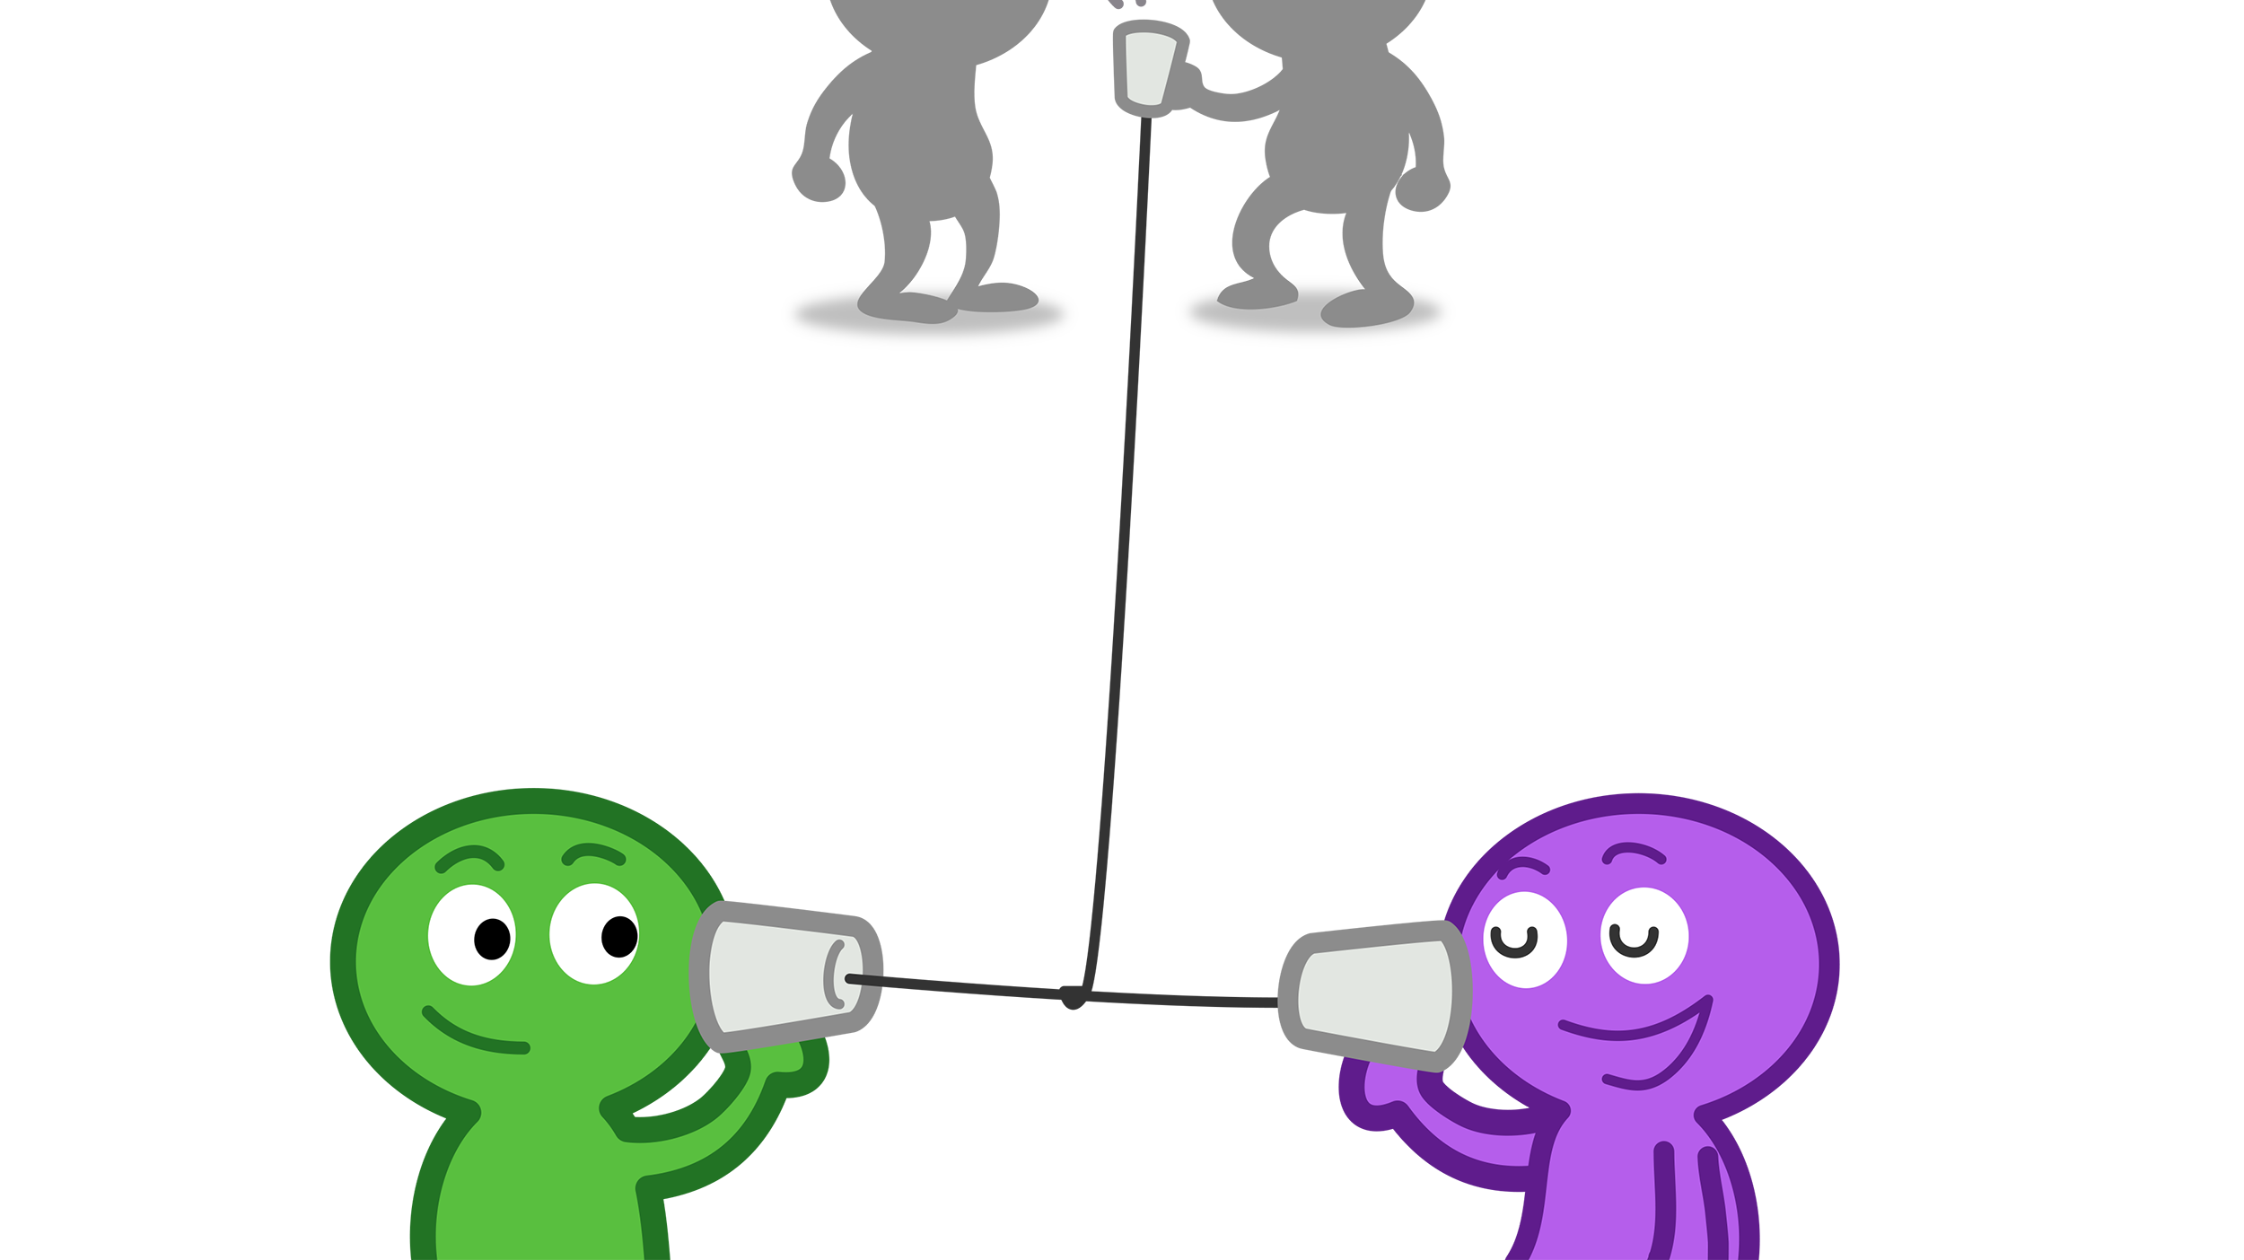
Audio-Related Privacy Perceptions and Design Recommendations from Guardians, Pragmatists and Cynics
Is Someone Listening ?

